Slide 1

Applied Physics
(Computer Science Department)
Diode and its applications
Half Wave Rectifier
Full Wave Rectifier
By: Mushtaque Ali
&
Saqib Hussain

Slide 2
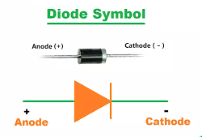
What is a Diode ?
A diode is an electrical component with two terminals that conducts electricity only in one direction.
On one end, it has a high resistance and low resistance on the other end.

Slide 3
Applications of the Diode
Diodes in Rectification
Diodes in logical gates
Diodes in clamping circuits
Diodes in the clipping circuits.

Slide 4
Things to remember
A diode is a two-terminal electronic component that conducts electricity in one direction.
It has high resistance on one end and low resistance on the other end.
In the symbol of a diode, the arrowhead represents the anode and the vertical bar represents the cathode.
The anode represents the conventional current flow direction in the forward-biased condition toward the cathode.
Diodes are commonly made up of only two semiconductor materials, Silicon and Germanium.

Slide 5
Rectifier
Applied Physics
(Computer Science Department)
A rectifier is an electronic device used to convert alternating current (AC) into direct current (DC).
This process is known as rectification.
A rectifier, consists of a transformer, a diode, and a filter circuit. All of these collectively convert AC to DC.

Slide 6
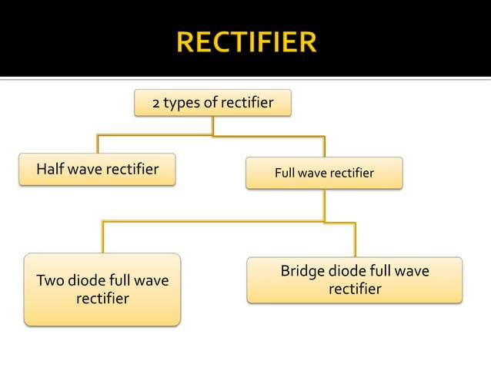
Applied Physics
(Computer Science Department)

Slide 7
Half-wave rectifier
Applied Physics
(Computer Science Department)
Half-wave rectifier: A rectifier that converts alternating current (AC) into direct current (DC) by allowing current flow in only one direction during half of the AC cycle, using a single diode.
In Half wave rectification, the rectifier conducts current during positive half cycle of input AC signal only.
Negative half cycle is suppressed.

Slide 8
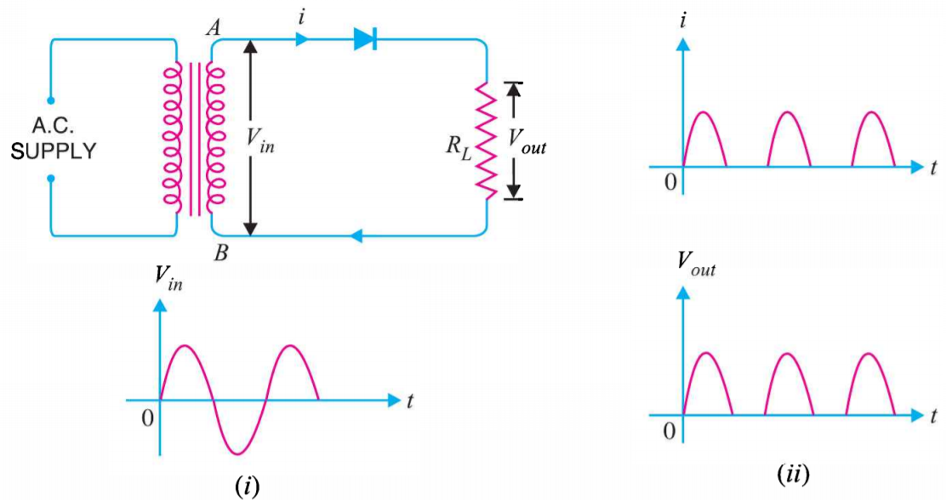
Half-wave rectifier: (cont.)
Circuit details and working mechanism:
The output across the load is pulsating d.c.

Slide 9
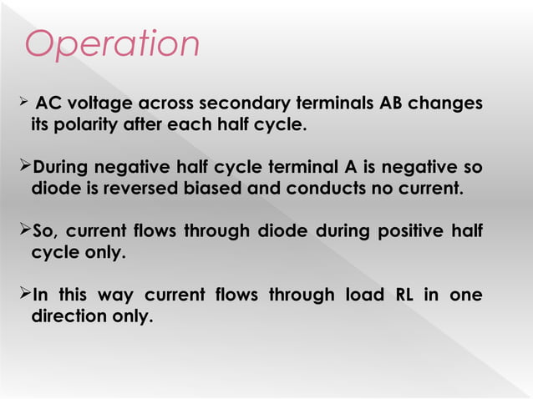
Applied Physics
(Computer Science Department)

Slide 10
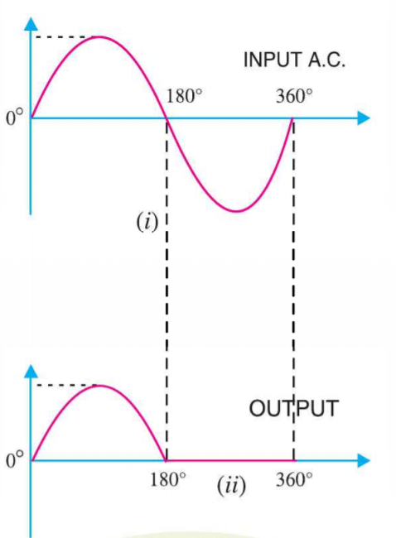

Output frequency of half-wave rectifier:
The output frequency of half-wave rectifier is equal to the input frequency (50 Hz).

Slide 11
Applications:
Half wave rectifier
Used in Pulse Generator Circuits for conversion from AC to DC.
Low-power DC supplies for small devices like smartphones or toys.
Demodulation of amplitude-modulated (AM) signals in communication systems.
Control of brightness in lighting applications, such as dimmer switches for incandescent bulbs.

Slide 12
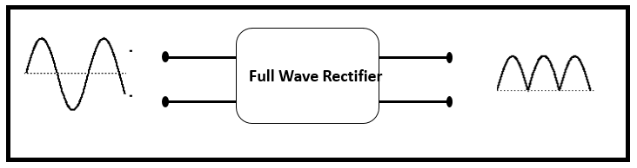
Full-wave rectifier
Full-wave rectifier: A rectifier that converts alternating current (AC) into direct current (DC) by allowing current flow through load in only one direction during both halves of the AC cycle.
It can be achieved with two diodes working alternatively, or a bridge rectifier, which uses four diodes arranged in a bridge configuration.
In full-wave rectifier, current flow towards load in the same direction for the both half cycles of input a.c. voltage
For positive half-cycle, one diode supplies current to load, for negative half cycle, second diode supplies current to load.

Slide 13
Two Diodes Full-wave rectifier (OR)
Center-Tap Full-Wave Rectifier
Applied Physics
(Computer Science Department)
Circuit has two diodes D1, D2 and a center tap transformer.
During positive half cycle, diode D1 conducts and during negative half cycle, diode D2 conducts current.
It can be seen that current through load RL is in the same direction for the both cycles.

Slide 14
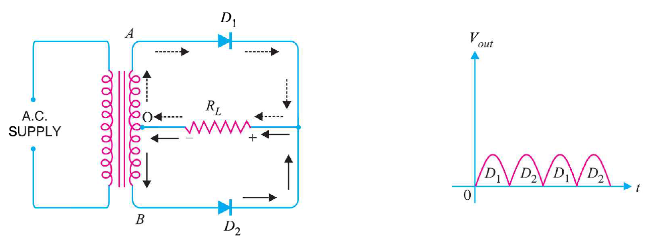
Two Diodes Full-wave rectifier Working Mechanism
Applied Physics
(Computer Science Department)

Slide 15
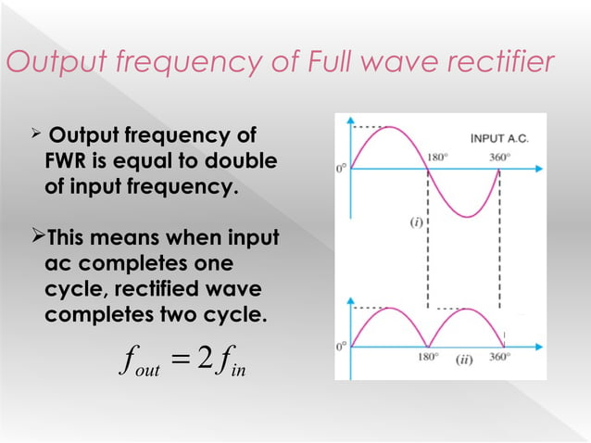

Slide 16
Bridge Diode Full-wave rectifier
In Bridge rectifier, four diodes are arranged in the form of a bridge.
The main advantage of this bridge circuit is that it does not require a special center tapped transformer.
The single secondary winding is connected to one side of the diode bridge network and the load to the other side.
This configuration provides same polarity output with either polarity.
The output is twice that of the center tap circuit for the same secondary voltage.
The PIV is one half that of the center-tap circuit.

Slide 17
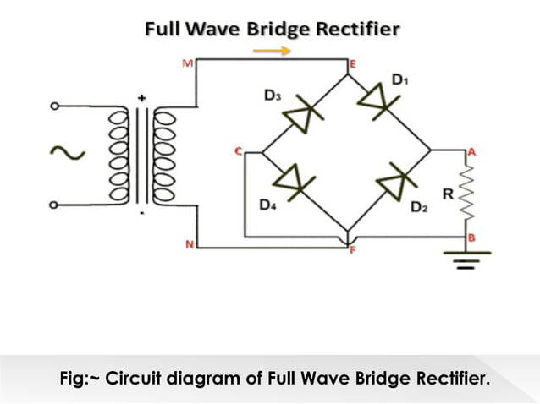
Bridge Diode Full-wave rectifier

Slide 18
Applications:
Full wave rectifier
Power supplies for electronic devices like computers, televisions, and industrial equipment.
Battery chargers for automotive batteries, UPS, and renewable energy systems.
DC motor drives for industrial and automotive systems.
Welding power supplies for stable and controllable power output in welding processes.

Slide 19
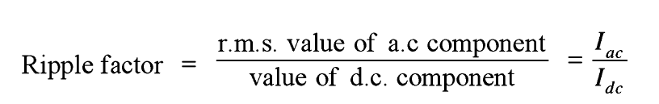
Ripple Factor
Ripple Factor
    The output current contains both AC and DC components . The ripple factor measures the percentage of AC component in the rectified output.
“The ratio of r.m.s. value of a.c. component to the d.c. component in the rectifier output is known as the ripple factor.”

Slide 20
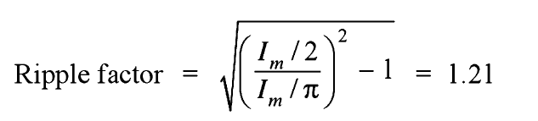
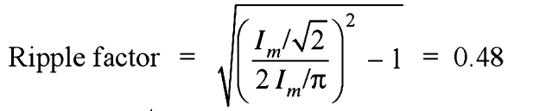
Ripple Factor: (cont.)
Mathematical analysis:
For Half wave rectification:
For Full wave rectification:

Slide 21
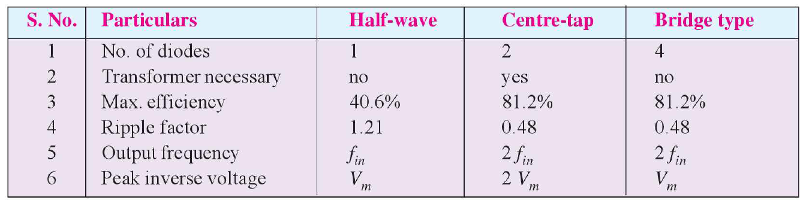
Comparison of rectifiers

Slide 22


Any Question

